Slide 1

Hotel Management system
Team:😐
Mohamed abdalgafar Badawy
Omar Ayman
Ali Taha
Ahmad shreef
Mohamed mosad

Slide 2
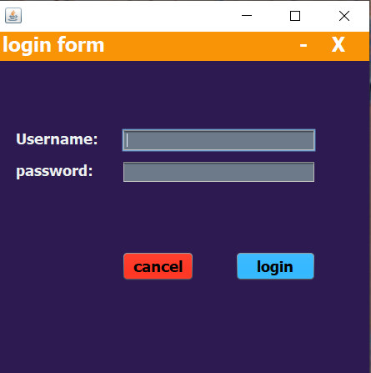
The Login G.U.I
The login G.U.I is the G.U.I that comes before the main G.U.I It contain the username and password of the admin or the user where the user or the admin can access to the main G.U.I by filling the username and password and click on the button login to go to the main G.U.I .

Slide 3
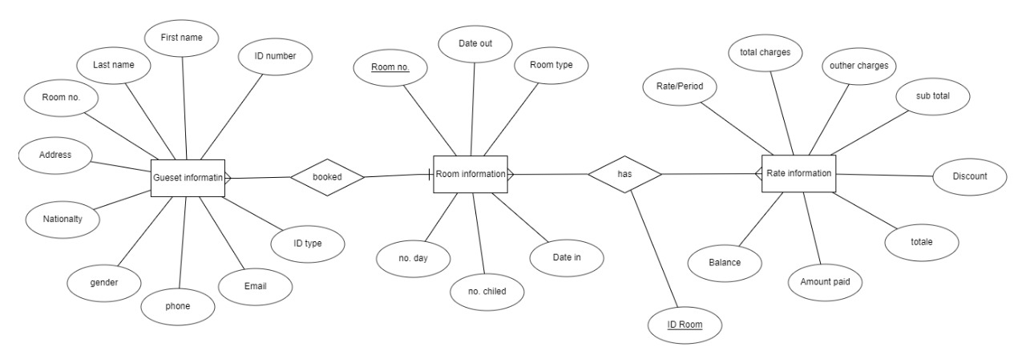
The E.R.D
It’s the base of the project and the most important component among the components of the system because without the E.R.D their won’t be mapping or database or G.U.I so simply the E.R.D is the base of the system.

Slide 4
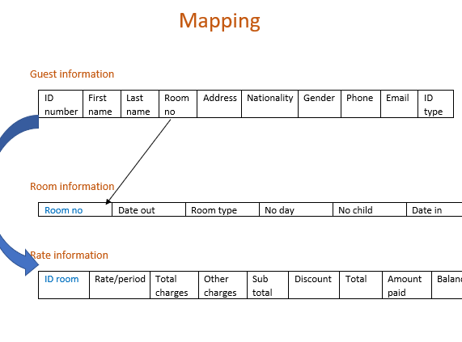
The MAPPING
It’s simply classified as the clarification of the E.R.D and it’s important as the user can understand the information that wrote in it and as it show in the figure front the room number in the first entity pointing at the room number in the second entity and the ID number in the first entity pointing at the ID room in the third entity and that means that there is a relation between the first and the second entity and the first and the third entity .

Slide 5



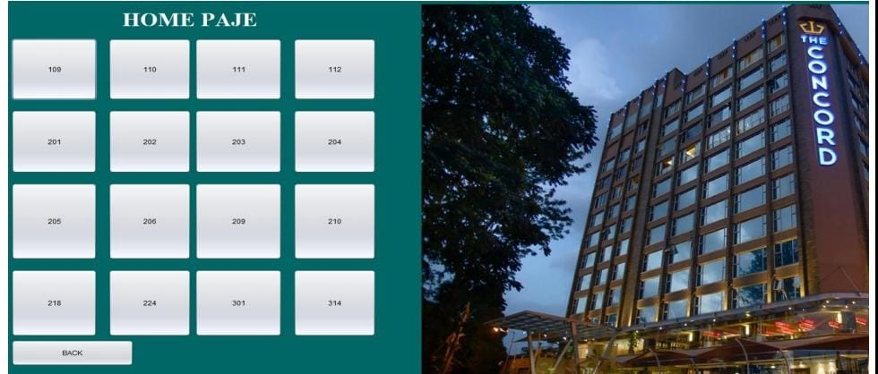

The MAIN G.U.I
The main G.U.I is the G.U.I at which the user see after the login page and it contain the information of the rooms of the hotel.

Slide 6
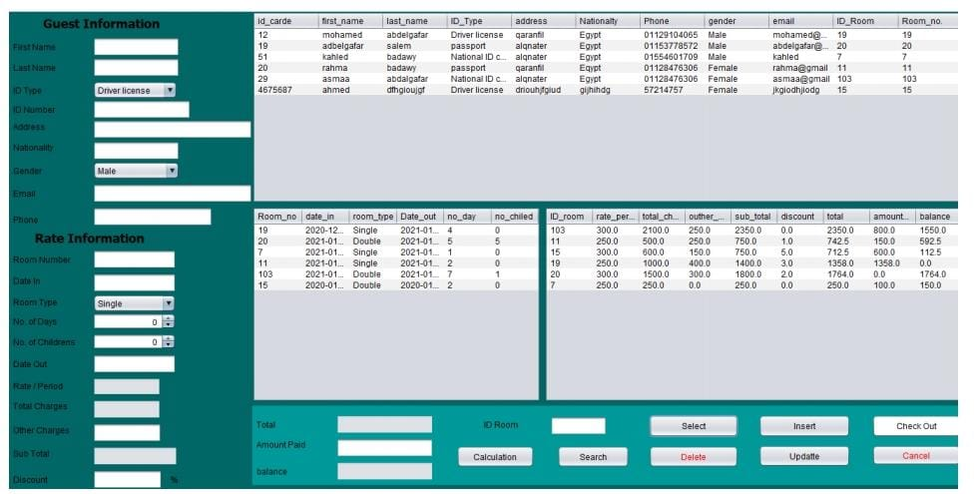
The Internal Main G.U.I
It’s the internal G.U.I of the previous main G.U.I as after the admin choose the room another G.U.I will open contain the information of the room and to see if it’s empty or not to give it to the user and complete it’s information.

Slide 7

Thanks .

